Slide 1

Movie Recommendation System

Slide 2
Phase 4 project
Student Name: Peter Kariuki Elizabeth
Class: Hybrid
Instructor: Winnie Anyoso

Slide 3
introduction
Today’s world has accumulated a lot of data which has resulted to information overload challenge. Users of movies in the online platforms, such as Netflix and YouTube face the challenge of discovering content based on their individual preference. This has led to the creation of a recommender system to offer personalized suggestions tailored for individual user profiles.
We’ll use collaborative filtering and content-based filtering approaches to build the movie recommendation system.

Slide 4
Problem statement
Popular streaming platforms such as Netflix and YouTube has a vast library of movies across different genres. This project wants to build a recommender system to enhance user experience and provide personalized movie recommendations.

Slide 5
objectives
Main Objective
To design, implement, and evaluate a recommender system that promotes both user engagement and satisfaction based on individual preferences.
Specific Objectives
To adopt machine learning algorithms and methodologies to create a recommendation engine that adapt dynamically to user behavior and preferences.
To transform user experience across a wide array of applications

Slide 6
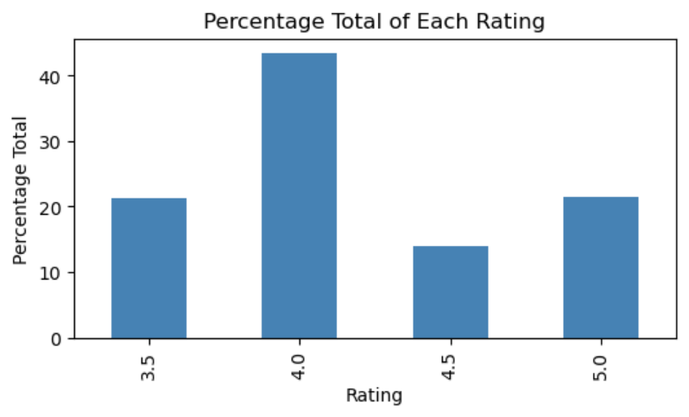
Visualizations: User ratings
We took a rating threshold of above 3.5 and realized that most users gave a rating of 4.0, above 40%.

Slide 7
results
Collaborative Filtering Approach
- We used K nearest neighbors algorithm to find the movies which are similar by selecting 10 nearest movies. This is done by looking at the cosine distance.
Content-based Filtering Approach
- We used this approach to address cold start issue by designing a model that selects movies based on their similarity. The model gives a similarity score depending on how movies are related. A similarity score of 1.0 implies that the movies are derived from the same genre.

Slide 8
conclusion
Various aspects were covered in building this recommendation system, which are;
Data Preparation: We began by loading and preparing the necessary data, including user ratings and movie information.
User-Item Matrix: We created a user-item matrix to represent user preferences for movies.
Qualification Criteria: We applied criteria to filter highly rated movies and active users, ensuring that the dataset used for recommendations meets specific quality standards.

Slide 9
<<conclusion>>
Sparsity Reduction: We used the csr_matrix from the scipy library to reduce the sparsity of the user-item matrix, which is beneficial for computational efficiency.
K-Nearest Neighbors (KNN): We implemented a KNN model using cosine similarity to find movies similar to a given one.
Content-Based Filtering: We used ontent-based filtering to recommend movies based on features like genres to address cold start problem.
Collaborative Filtering: We used collaborative filtering to recommend movies based on the users preferences.

Slide 10
THANK YOU

